Slide 1















community journalism
Eco Week Competition

Slide 2











List of contents
What is Community Journalism?
Hear from our Community Blogger
How can it make a difference?
What can I write about?
The 5 Ws
Videos and Photos
Eco Week Competition

Slide 3







What is community journalism?
Community journalism is when people like you tell real stories about what's happening around them—in their school, neighborhood, or town!
What questions do you want to know the answers to?

Slide 4




Our Community blogger
The first blog I wrote was as a volunteer for the Wildlife Trust. It was about a group of orphaned baby squirrels, their rescue and their release back into the wild. This led to other blogs and when I found out that Groundswell were looking for a community blogger, I sent a pitch email including links to my work. This is how I got into community journalism.
For me, the most enjoyable part of community journalism is visiting different projects and speaking to the people who run them. Each one has been unique and having the opportunity to see how they work, what ideas they have and how much they help people has been both interesting and fun.
Kassy Price
A blog by Kassy

Slide 5



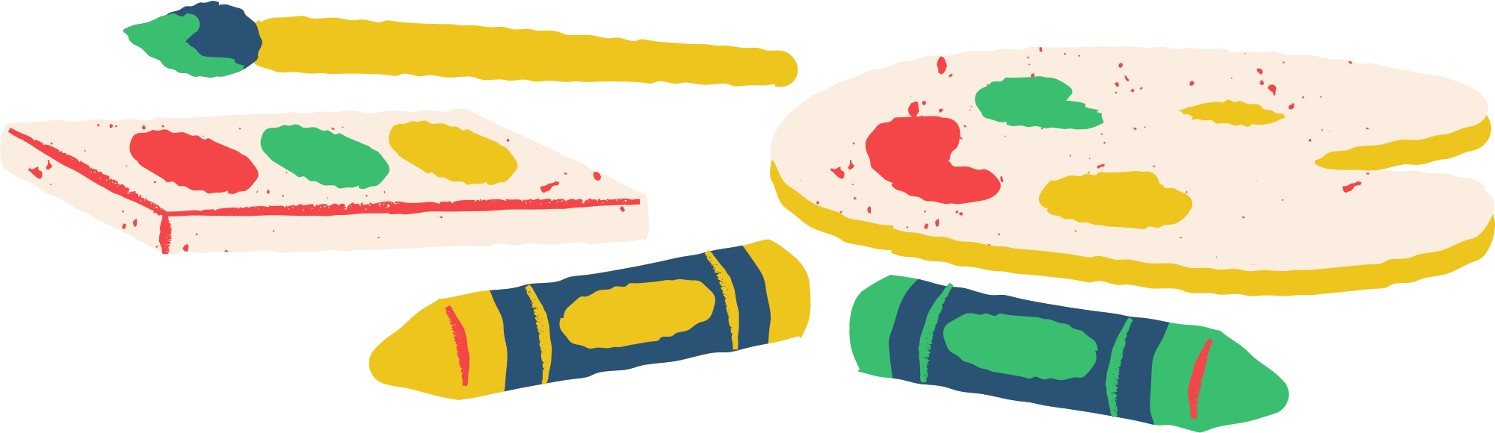
how can it make a difference?
Stories can make people listen.
When you speak up, things can change!

Slide 6





what could i write about?
  Pollution in your area
  Trees or wildlife nearby
  Water in your school or community
  Recycling (or not!)
  Energy use at home/school
  Something positive (like a garden or project!)

Slide 7







the 5 w’S
Every great story starts with questions! Ask yourself:
Who is involved?
What happened?
Where did it happen?
When did it happen?
Why does it matter?
And don’t forget How it happened!

Slide 8
let’s try that out
What happened?
Where did it happen?
Who is involved?
Why does it matter?
When did it happen?
How did it happen?

Slide 9








Using videos and photos
Using your own photos is best!
Steps:
  Plan your story (draw it out!)
  Record with good sound & light
  Cut out mistakes
  Add titles and music (optional)
Even a phone or tablet works. Use apps like iMovie, CapCut, or WeVideo. Make it clear, fun, and about your message.

Slide 10









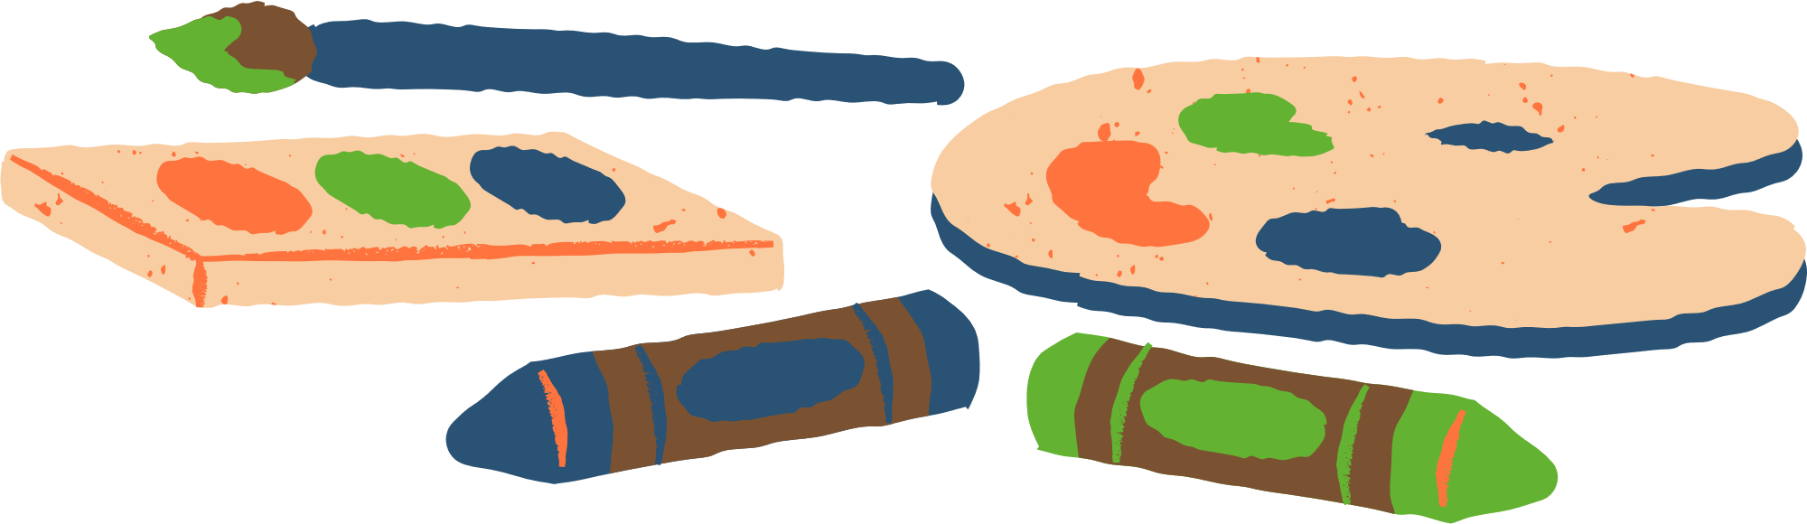
where can i get more help?
Storyboard Templates
Free music for films (Moby)
Free stock photos (Pexels)
BBC Bitesize - Creating Video and Audio
BBC Bitesize - Young Reporter
How to check your sources

Slide 11


eco week competition
Send entries to:
  One entry per school
  Can be written, video, or photo story
  Must be about an environmental issue that matters to YOU
  Deadline: Friday 30th June 5pm
  Judges are real community journalists and environmental researchers!
  Prize: £200 in vouchers for your school
  Top 3 entries will be featured on the GroundsWell website and Liverpool City Council Social Media
groundswell@liverpool.ac.uk
TOp tip
Get together as a group and list all your key facts

Slide 12

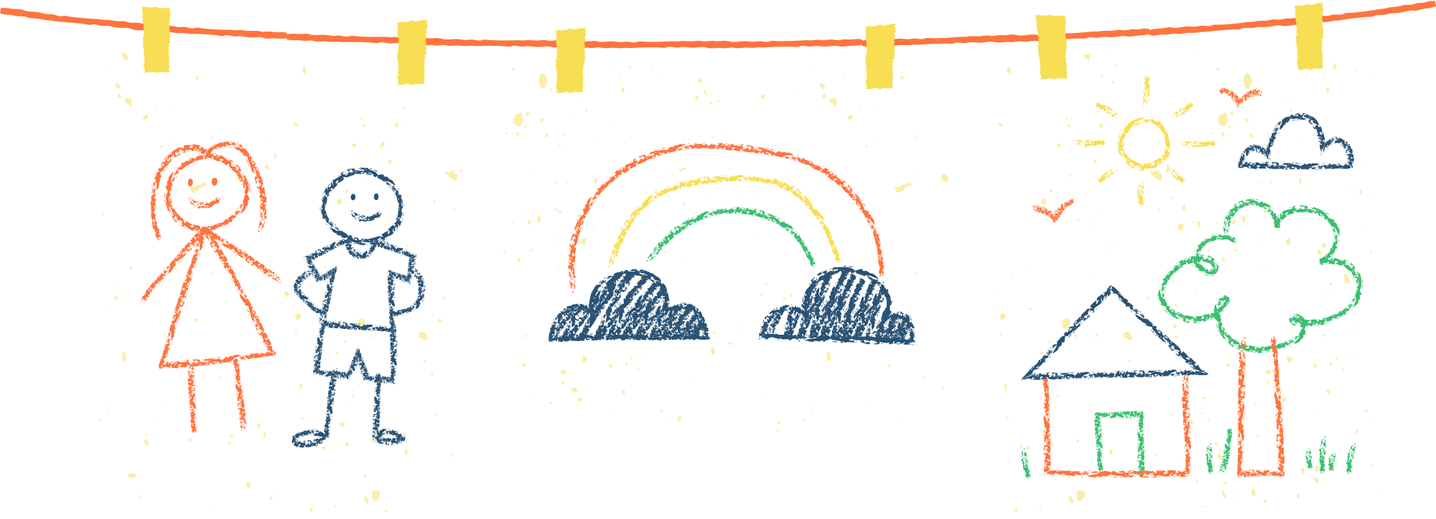







let’s get started!
start talking in your groups about what you might like to write/video/ask questions about

Slide 13

Recently, the increase of litter and fly-tipping has concerned the Year 5 pupils of Holmleigh Primary School in Hackney.
According to pupils, littering is not only affecting people’s mental health, it is also having an impact on where children are playing. Kaiden, 10, said that he was playing with his friends when he tripped on a bottle and grazed his hands and hurt his knee. He said: “I could not play outside for a month.”
Julia, 10, said: “When I was walking to school, I saw some boxes and glass inside a box under a tree. It felt really dangerous and I was really scared about hurting myself.”
The class contacted their local councillors who told them that police officers don’t enforce littering and fly tipping laws, that is down to local councils. The money from fines is invested back into the council’s environmental services and can be used for many things, like playing for some of the cost of providing enforcement officers to tackle littering and fly tipping, or perhaps for providing more recycling bins.
The class also sent an email to their local MP, Diane Abbott, who answered their questions saying that waste dumping or fly tipping is a serious concern for the local community. Diane Abbott’s office told the pupils that there are over 387 cameras on highways and other public spaces, and another 1980 cameras located across council housing estates. These primarily focus on safety but also pick up on littering and fly-tipping. This cost Dalston £148, 800 last year, slightly less than £500 a day.
Year 5 have also contacted Stamford Hill Unites. They came to Year 5 and were asked some questions. One of their aims is to clean up the local streets and raise awareness about this issue.
The council is currently piloting a project aimed at encouraging local businesses to reduce food waste and minimise packaging. Participating businesses can display a special window sticker to show their commitment to these things. Currently, seven businesses are enrolled, with ongoing efforts to include more. Participants in the project need to meet certain criteria, including reduce food waste.
All Hackney streets have at least two rubbish collections a week. There are also at least one hundred litterbins on Hackney roads.
Hackney council also offers recycling collections that are half the cost of other waste collections.
writing examples
Longwood pupils were devastated when they found out that they couldn't swim due to Storm Kathleen's winds blowing and breaking the tent on Saturday 6 April.
Mrs Orton, the Longwood Primary School caretaker, was the first to see the disaster at about half past five in the afternoon. Mrs Orton photographed some of the damage and emailed them to the headteacher of Longwood, Mrs James. Mrs Orton explained: “I came down to leave food for the fox.”
Fortunately, there were no injuries or permanent damage.
There was a message sent out to the parents to let them know swimming was cancelled for a week.
After the tent was fixed, the builders realised that the pool needed emptying and refilling because the pool was brimming with leaves, bugs and all other sorts of gunk.
Pupils of Longwood Primary are now swimming once again with a new safety tent.
Longwood pupils are very happy and excited that they can go swimming and have the opportunity to learn how to swim and gain skills again.

Slide 14
GOOD LUCK!
Any questions email: groundswell@liverpool.ac.uk

